Slide 1
RNA-seq

Slide 2
Introduction
Associate Bioinformatics Scientist at Coriell Institute for Medical Research
Help other people with their data analysis
Independent data analysis
All materials for my lectures will be online at https://kelseykeith.github.io/2020_bmsc8203_bioinformatics_lectures/
Notes:
Ask about background:
Has anyone done RNA-seq either made a library or analyzed it?

Slide 3
History of NGS Sequencing? / How does Illumina sequencing work?

Slide 4
What is RNA-seq and how does it work?

Slide 5
What is RNA-seq?
RNA-seq = RNA sequencing
Use next generation sequencing to quantify RNA in a cell
Mainly when people do RNA-seq they’re concerned with mature messenger RNA, because they want to know what genes are expressed
Stark 2019, Image: Wikipedia
Notes:
By The original uploader was Sverdrup at English Wikipedia. - [1](file)Originally from en.wikipedia; description page is/was here., Public Domain, https://commons.wikimedia.org/w/index.php?curid=2120822

Slide 6
How are RNA-seq libraries prepared?
Capture RNA
Poly-A Capture
Ribo-Zero
Fragment
Reverse transcribe to make cDNA
PCR amplification
Sequencing adapters
PCR bias
Illumina sequencing
Align to a reference genome
Count number of reads that correspond to each gene
Stark 2019, Image: Wikipedia
Notes:
Shafee, Thomas (2017). "Eukaryotic and prokaryotic gene structure". WikiJournal of Medicine 4 (1). DOI:10.15347/wjm/2017.002. ISSN 2002-4436.

Slide 7
Designing an RNA-seq Experiment
Minimum experiment is 3 control samples vs 3 experimental samples
Examples:
3 control samples vs 3 samples treated with a drug
3 samples in young mouse intestine vs 3 samples in old mouse intestine
3 samples from germ free (no microbiome) mice vs 3 samples from normal mice
You need 3 replicates per condition MINIMUM
Statistically need at least replicates in order to calculate variance
Can have multiple conditions
Limited by budget
Increases the complexity of analysis
Stark 2019
Notes:
Examples
3 control samples vs 3 samples treated with a drug
3 samples in young mouse intestine vs 3 samples in old mouse intestine
3 samples from germ free (no microbiome) mice vs 3 samples from normal mice

Slide 8
Designing an RNA-seq Experiment: Isolating RNA
Poly-A Capture
ISSUE: Most RNA (80-90%) is ribosomal RNA that we’re not interested in
Poly-A Capture
Use an oligo-dT primer complimentary to the poly-A tail of mature mRNA
Better at capturing only RNAs that correspond to expressed genes
Ribosomal Depletion
Have sequences complimentary to ribosomal RNA on magnetic beads.
Sequence more non-coding RNAs, but some experiments want that
The strategy you choose DOES effect your results
Ribosomal Depletion
Zhao 2018, top image: Thermo Fisher, bottom image: Illumina
Notes:
Top Image, Poly-A Capture, Thermo Fisher: https://www.thermofisher.com/us/en/home/life-science/sequencing/next-generation-sequencing/ngs-library-preparation-illumina-systems/collibri-stranded-rna-library-prep-kits/collibri-3-prime-mrna-library-prep-kits.html
Bottom image, Ribo-Zero, Illumina: https://sapac.support.illumina.com/bulletins/2019/10/best-practices-to-minimize-rrna-contamination-in-truseq-stranded.html

Slide 9
Designing an RNA-seq Experiment: Picking the Sequencing Type
Read Length
Longer the read length the more sequence overlap / coverage
More expensive as read length increases
Sequencing company charges more
Also more like to read into adapters which is a waste of money
Single vs Paired-End Reads
Single-end is cheap and simple
Paired-end
Get 2 or more times the information from the same DNA
Good for repetitive RNA
Necessary for splicing
Single-End
Paired-End
Sequencing
Aligning
Illumina
Notes:
Illumina: Designing Your Experimental Protocol https://www.illumina.com/science/technology/next-generation-sequencing/plan-experiments.html

Slide 10
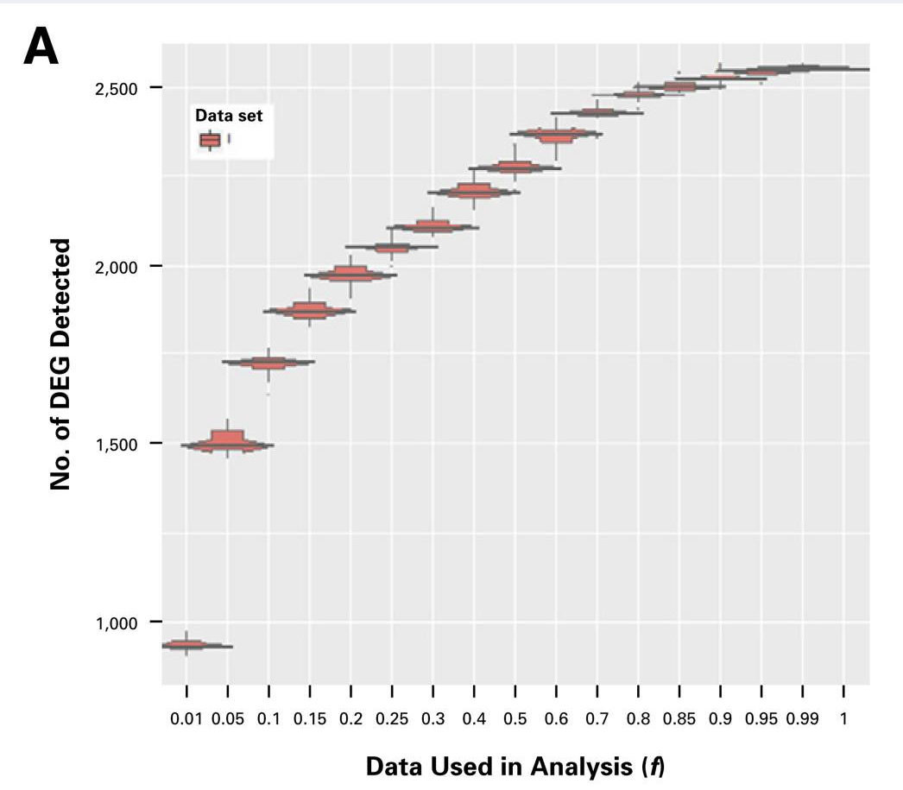
Designing an RNA-seq Experiment: Sequencing Depth
Sequencing depth
Standard depth is ~30 million reads per sample
If you’re looking for very lowly expressed genes, may need to sequence more, but this should be fine for most experiments
For plot - 50 million reads total. 1 = all 50 millions reads used
Stupnikov 2018

Slide 11
Analyzing RNA-seq

Slide 12
Processing Sequencing Data
Remove unwanted sequences
Align to reference genome
Count feature of interest
Filter and normalize.
Remove low counts
Remove features with low read depth
Compensate for differences in library size
Stark 2019

Slide 13
Differential Gene Expression
Is there is difference in expression of this gene between my conditions?
Can use a variety of statistical tests, but most common practice is a linear model
Test association of each gene with phenotype or condition
Correct for multiple testing
Stark 2019

Slide 14
Pathway Analysis
Pathway | Score | P-value | Q-value
Binding and Uptake of Ligands by Scavenger Receptors | 0.88 | 0.0001 | 0.001
Beta oxidation of lauroyl-CoA to decanoyl-CoA-CoA | 0.72 | 0.0078 | 0.0156
mitochondrial fatty acid beta-oxidation of unsaturated fatty acids | 0.65 | 0.0050 | 0.0125
NOTCH1 Intracellular Domain Regulates Transcription | 0.63 | 0.0034 | 0.0113
Creatine metabolism | 0.45 | 0.0022 | 0.0110
Abasic sugar-phosphate removal via the single-nucleotide replacement pathway | 0.33 | 0.0100 | 0.0167
ARMS-mediated activation | -0.37 | 0.0200 | 0.0286
Estrogen-dependent nuclear events downstream of ESR-membrane signaling | -0.55 | 0.0300 | 0.0375
Axonal growth inhibition (RHOA activation) | -0.78 | 0.0500 | 0.0500
E3 ubiquitin ligases ubiquitinate target proteins | -0.79 | 0.0500 | 0.0500
Do I see a bunch of genes that are known to work together?
over-representation analysis (ORA)
Do I see more genes from this pathway than I expect by chance?
functional class scoring methods (FCS)
Same thing, but incorporates expression values. Idea is coordinated, but not necessarily larges changes in expression could be important.
Great free webtool is the Consensus Path Database http://cpdb.molgen.mpg.de/
Nyguen
2019

Slide 15
What else can you look at with RNA-seq?
Transcript level quantification
Alternative splicing
Small RNAs like miRNA, etc…
Transposable elements
Ribosomal RNA
Mutations like single nucleotide variants (SNVs), small insertions or deletions (indels), or copy number variations (CNVs)
Stark 2019

Slide 16
PLAY WITH DATA
https://infinityloop.shinyapps.io/TCC-GUI/

Slide 17
Single Cell RNA-seq

Slide 18
What is single cell RNA-seq and why do we need it?
Issues with bulk RNA-seq that single-cell RNA-seq overcomes
Average of multiple cell types
Diversity in expression
Where in the tissue was it?
Challenges that still need to be addressed
What cell type is this? (cell atlases are working on it)
Data sparsity and measurement uncertainty
Cost, ~10x more expensive than bulk RNA-seq
When should I use single cell sequencing? When you want to test something in multiple cell types
Stark 2019

Slide 19
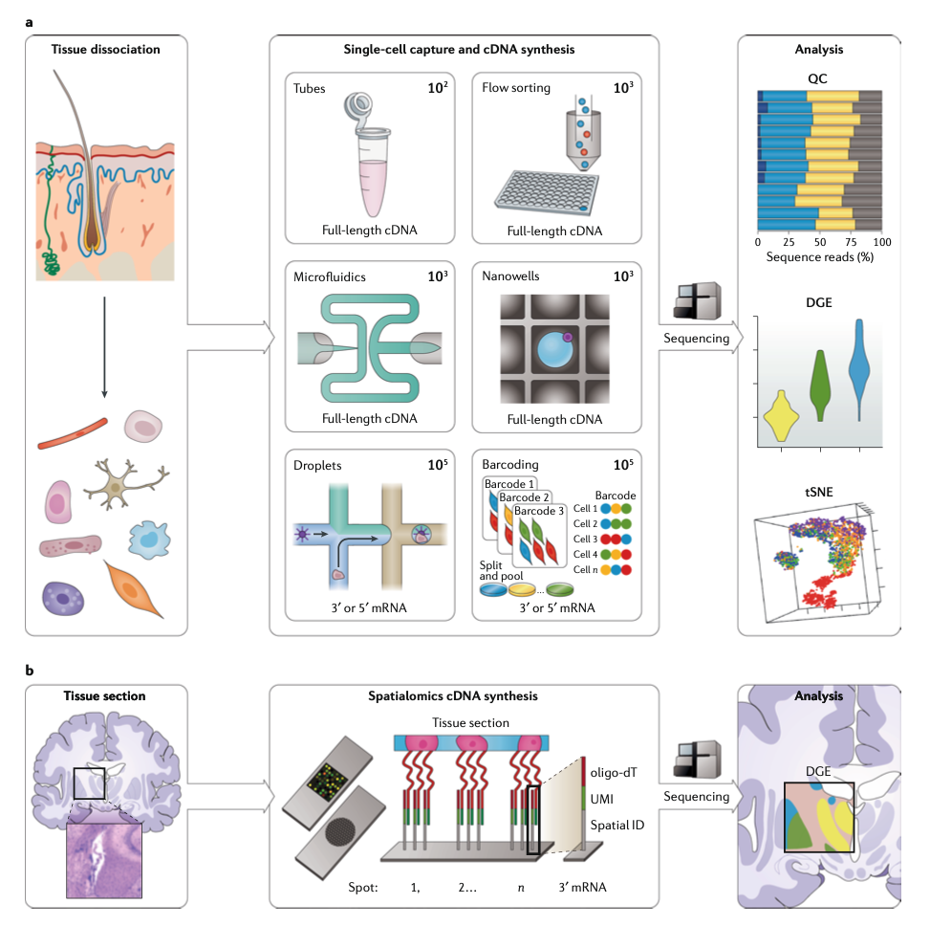
Single Cell Analysis
Overall strategy: Isolate single cells and attach a barcode to them.
Isolation
Flow sorting
Microfluidics / droplet encapsulation
Barcoding
Capture oligos either on a slide or a bead
Indexed PCR primers
Sequence everything together
Computationally sort cells apart when processing data
Stark 2019

Slide 20
References
Nguyen, T., Shafi, A., Nguyen, T. et al. Identifying significantly impacted pathways: a comprehensive review and assessment. Genome Biol 20, 203 (2019). https://doi.org/10.1186/s13059-019-1790-4
Stark, R., Grzelak, M. & Hadfield, J. RNA sequencing: the teenage years. Nat Rev Genet 20, 631–656 (2019). https://doi.org/10.1038/s41576-019-0150-2
Stupnikov, A. et al. Impact of Variable RNA-Sequencing Depth on Gene Expression Signatures and Target Compound Robustness: Case Study Examining Brain Tumor (Glioma) Disease Progression. JCO Precision Oncology 1–17 (2018) doi:10.1200/po.18.00014
Zhao, S., Zhang, Y., Gamini, R. et al. Evaluation of two main RNA-seq approaches for gene quantification in clinical RNA sequencing: polyA+ selection versus rRNA depletion. Sci Rep 8, 4781 (2018). https://doi.org/10.1038/s41598-018-23226-4

Slide 21
How to can I get started in bioinformatics on my own? (A collection of free online resources)
Learn a scripting language
R https://r4ds.had.co.nz/
Python https://jakevdp.github.io/PythonDataScienceHandbook/
Take a free online genomics, biostatistics, bioinformatics classes
Biomedical Data Science http://genomicsclass.github.io/book/
Modern Statistics for Modern Biology http://web.stanford.edu/class/bios221/book/index.html
Bioinformatics Data Skills https://vincebuffalo.com/book/ (book not free sorry!)
Go to a MeetUp
RLadies Philly https://www.meetup.com/rladies-philly/
Philadelphia Python Users Group https://vincebuffalo.com/book/

